Slide 1
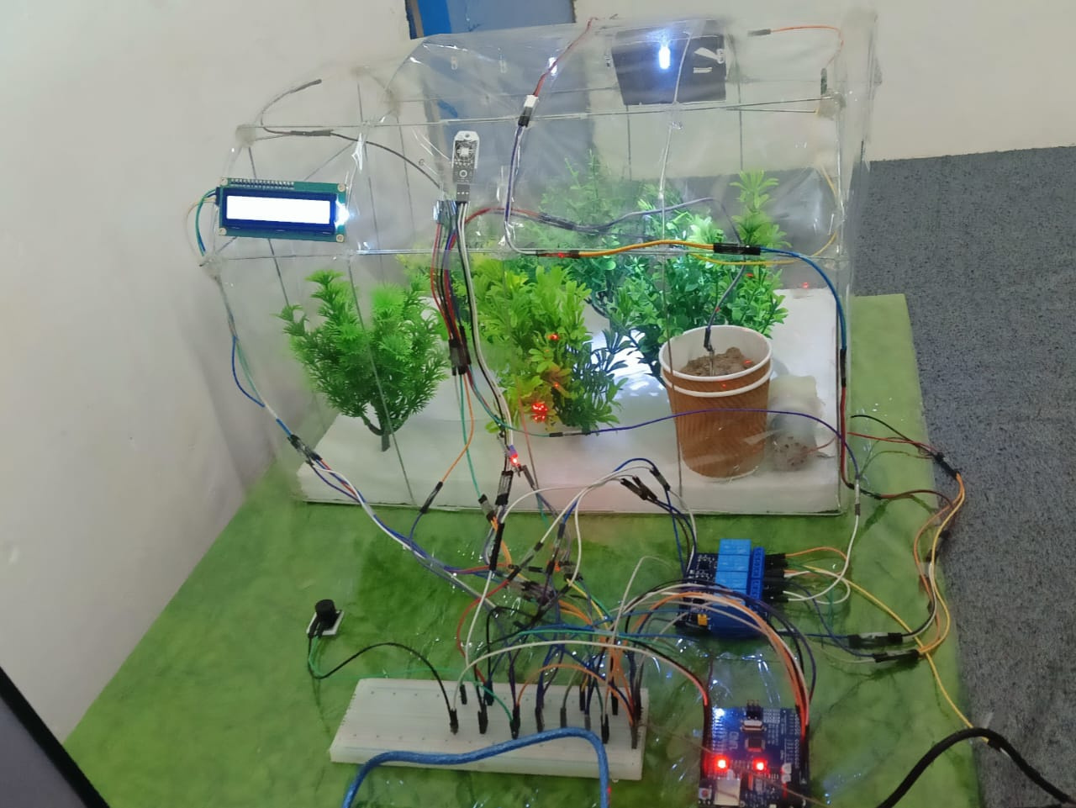
Automation in Greenhouse Climate Control – Managing Ventilation, Humidity, and Lighting Using Arduino
Presented by Satyam Kumar and Prince Patel

Slide 2
PROBLEM IDENTIFICATION
Greenhouse conditions are currently monitored manually, leading to slow responses.
Temperature, humidity, soil moisture, and light levels fluctuate rapidly and are not controlled automatically.
Plants often experience stress due to delayed human intervention.
Manual operation of fan, pump, and lights leads to inconsistent climate regulation.
Human errors cause over‑watering or under‑watering, harming plant growth.
Fans or lights may remain ON longer than required, causing energy wastage.
No system exists to continuously track environmental data in real time.
2

Slide 3
PROBLEM IDENTIFICATION
Farmers cannot stay in the greenhouse 24/7, causing periods of poor control.
Small-scale growers lack access to affordable automation solutions.
Data such as temperature, humidity, and soil moisture are not visualized together, making decisions difficult.
Manual climate control results in uneven plant growth across the greenhouse.
Lack of alerts means critical conditions (like overheating) often go unnoticed.
Traditional systems require more labor, increasing cost and effort.
Absence of an automated system reduces overall productivity and plant yield.
3

Slide 4
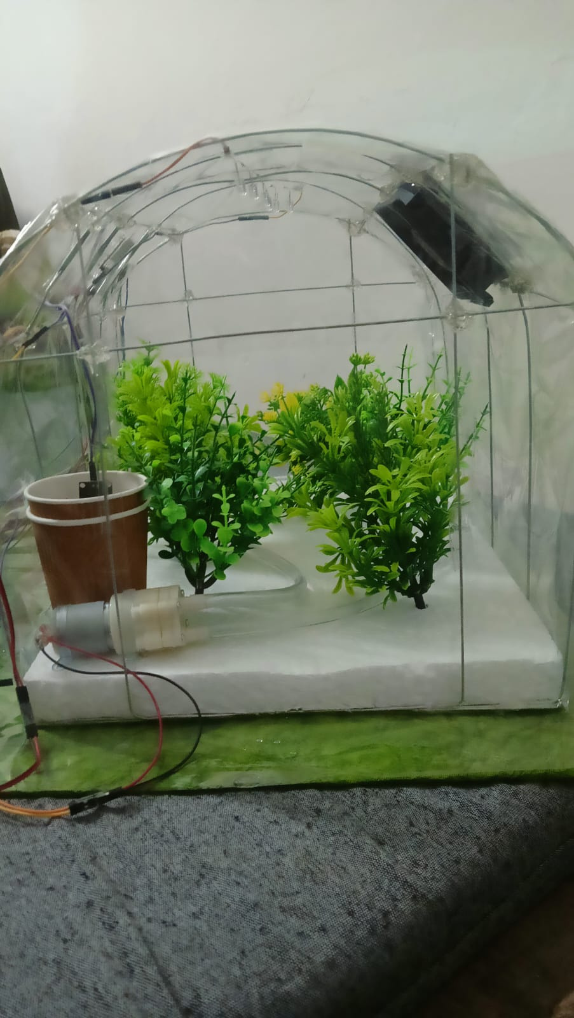
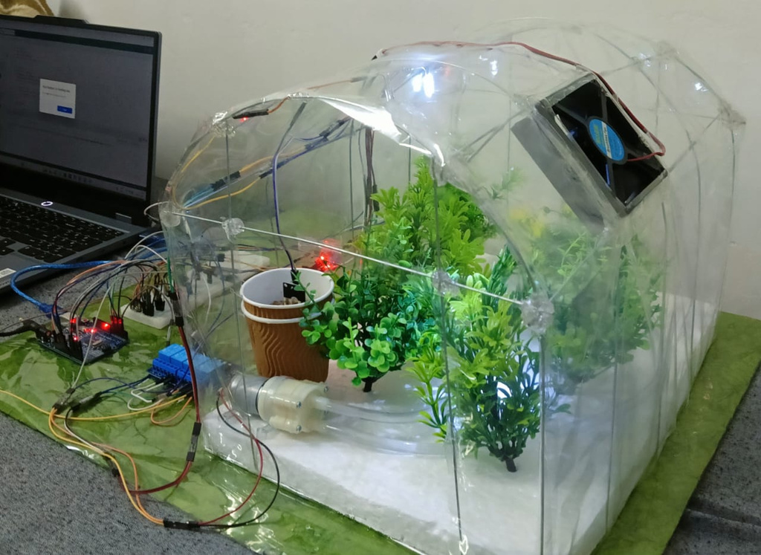

The Need for Automation
Improved Growth
Energy Efficiency
Consistent Climate
Automation enhances plant growth by creating optimal conditions for photosynthesis and nutrient uptake.
Automated systems reduce energy consumption by optimizing resource use and minimizing waste throughout operations.
Consistent climate control ensures stable growth conditions, resulting in higher yields and healthier plants.

Slide 5
Benefits of Greenhouse Automation
Ensures precise and real-time monitoring of temperature, humidity, light, and soil moisture.
Maintains a stable microclimate, improving overall crop quality and productivity.
Enables automatic control of ventilation and exhaust systems to prevent heat buildup.
Reduces unnecessary energy consumption through smart lighting automation.
Optimizes water usage by operating irrigation systems only when required.
Minimizes manual intervention, reducing labor dependency and human errors.
Helps in early detection of abnormal conditions through system-generated alerts.
Reduces the risk of pest infestation, fungal infections, and moisture-related plant diseases.
5

Slide 6
Benefits of Greenhouse Automation
Improves yield consistency by maintaining ideal environmental conditions 24×7.
Enhances greenhouse scalability for commercial and precision agriculture applications.
Provides safe electrical equipment control using isolated relay-based actuation.
Supports data transparency by displaying live system status on an LCD/monitor.
Increases resource-use efficiency, lowering operational costs and improving profit margins.
Contributes toward sustainable and climate-resilient farming practices.
Offers future enhancement potential with IoT integration, AI-based decisions, and mobile notifications.
6

Slide 7
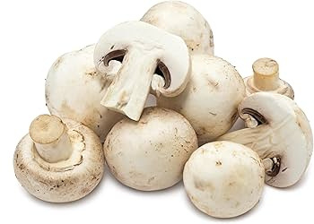
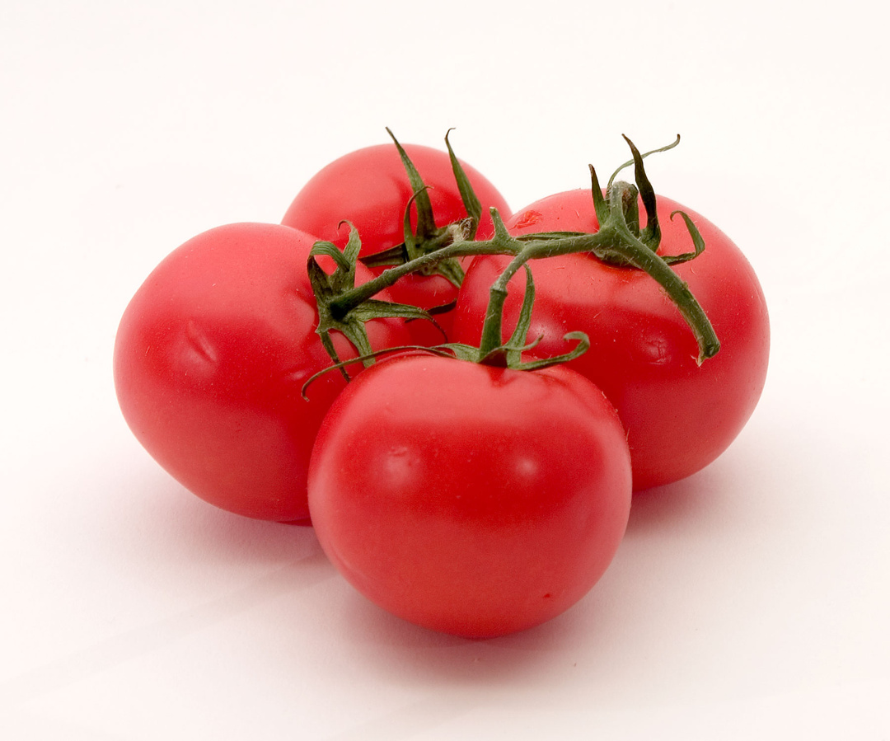

Crop Examples Section
Mushroom
Tomato
Spinach
Auto water + light → leaves stay green, soft, and fresh.
Needs steady temperature + high humidity. Automation keeps both constant → faster growth, bigger size.
Vent/fan auto-ON when hot → prevents flower drop → more tomatoes.

Slide 8
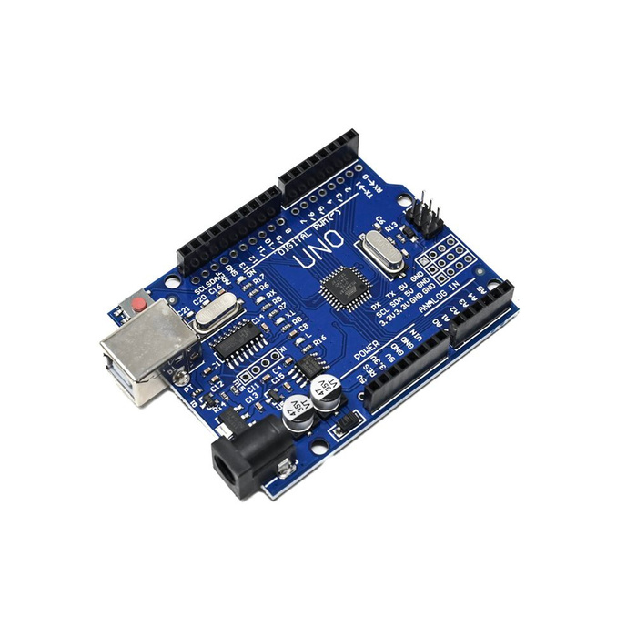
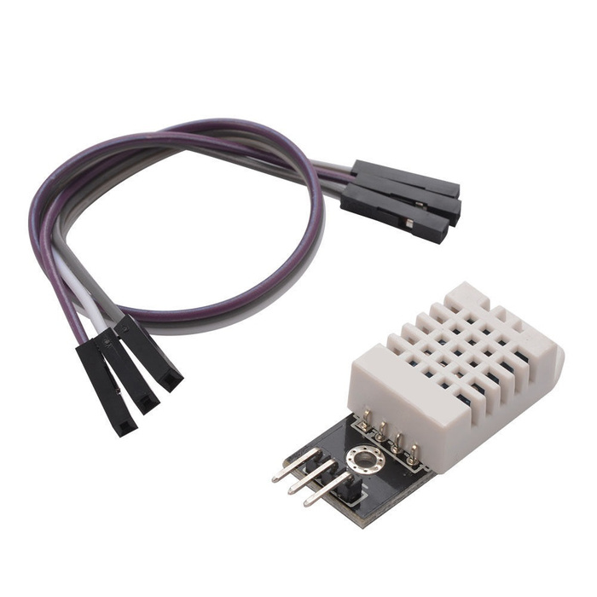

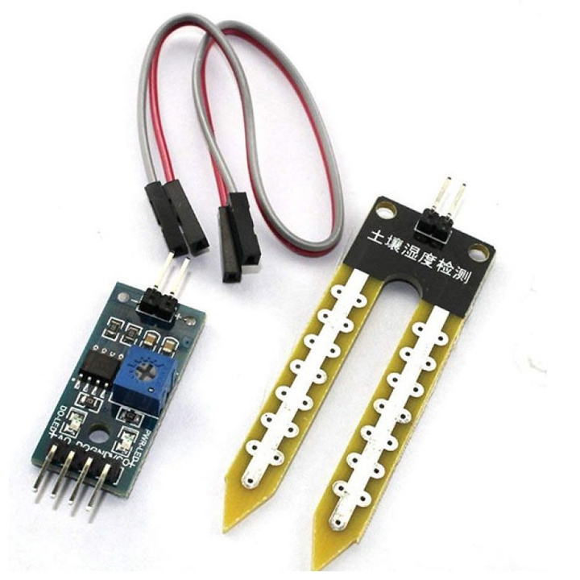
Overview of Actuators in Greenhouse Control
Arduino Uno
DHT22
It's a small board with a microcontroller (ATmega328P)
Digital Temperature and Humidity Sensor
LDR Sensor
Soil Moisture Meter
detect or measure light intensity
Soil Humidity Sensor

Slide 9
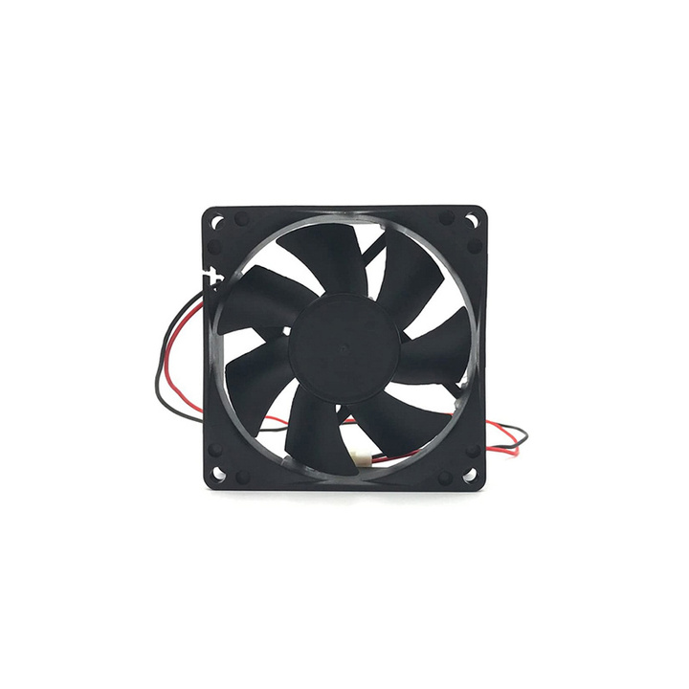
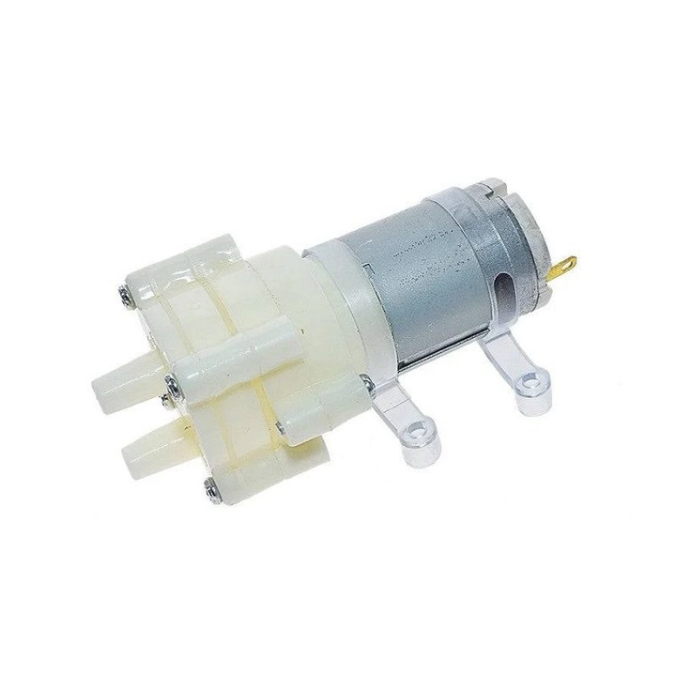
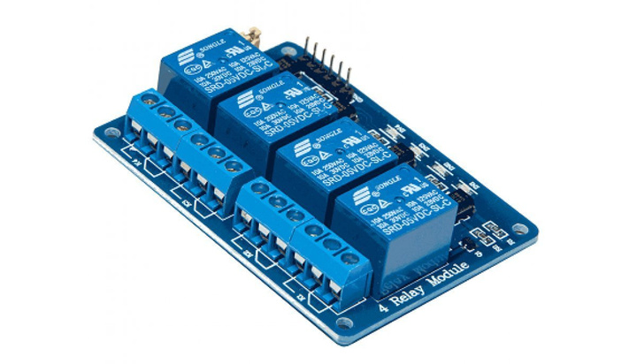
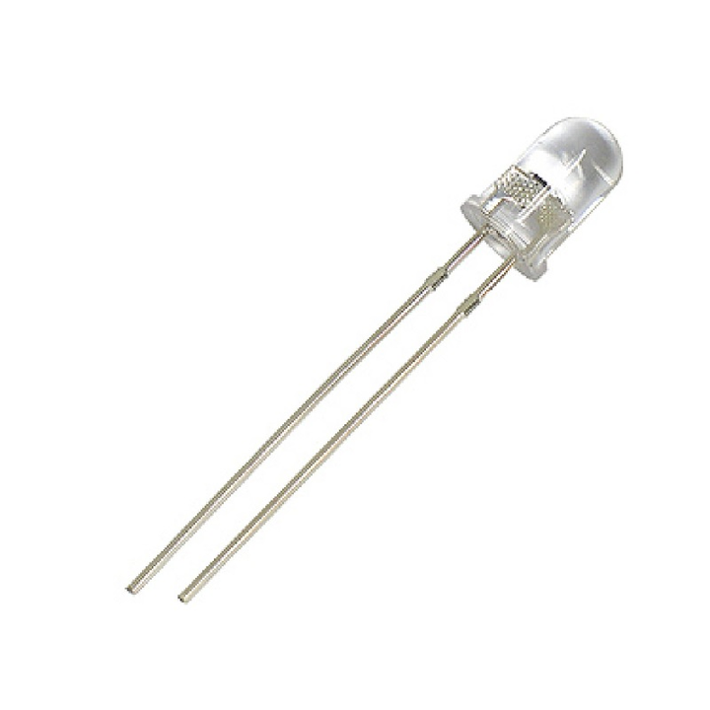
Overview of Actuators in Greenhouse Control
Fans
Water Motor
Essential for maintaining optimal air circulation.
Pumps water for irrigation to maintain soil moisture levels.
4 Channel Relay Module
LED Lights
Provides essential light spectrum for growth.
electrical switch controlled by Arduino

Slide 10
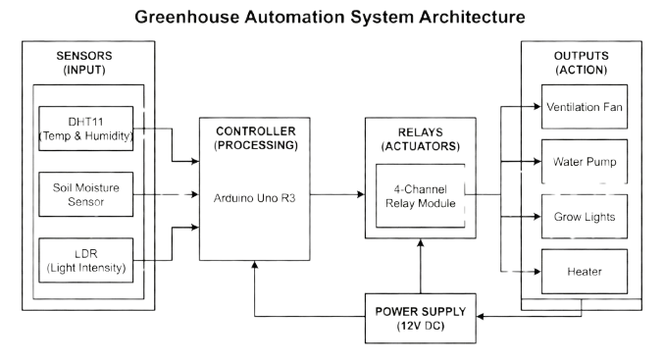

Slide 11
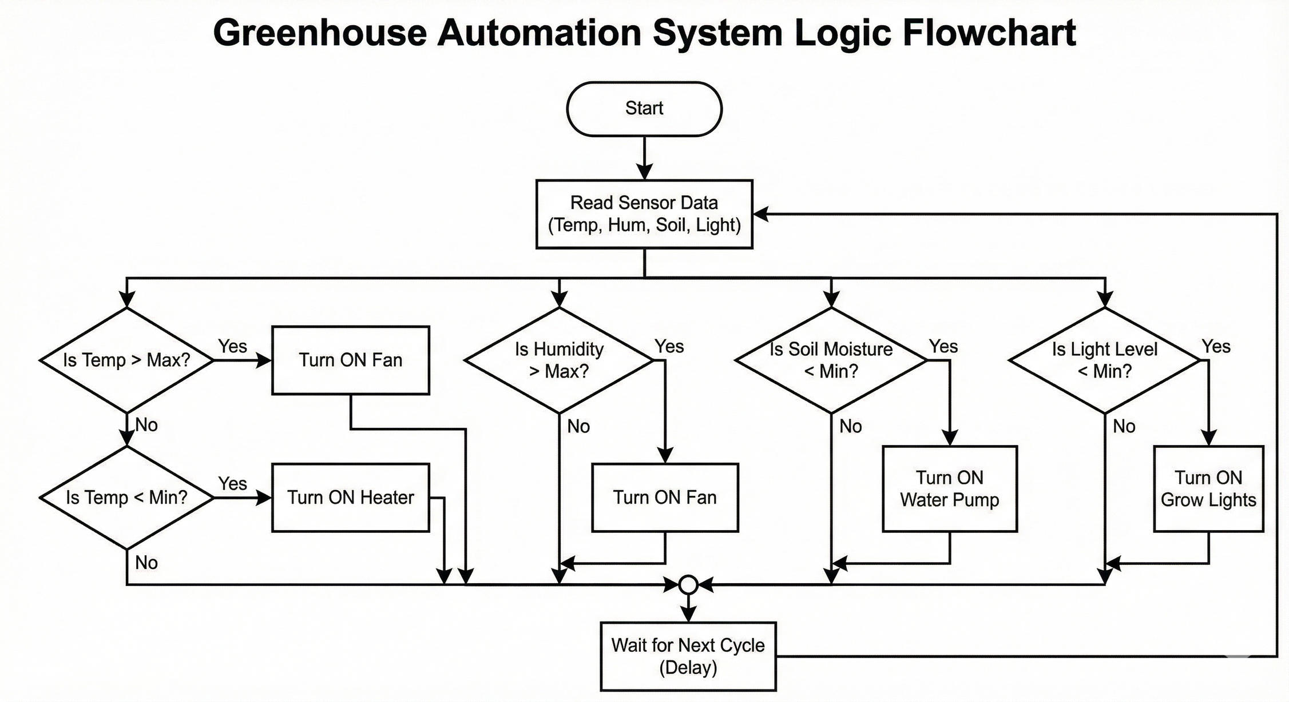

Slide 12
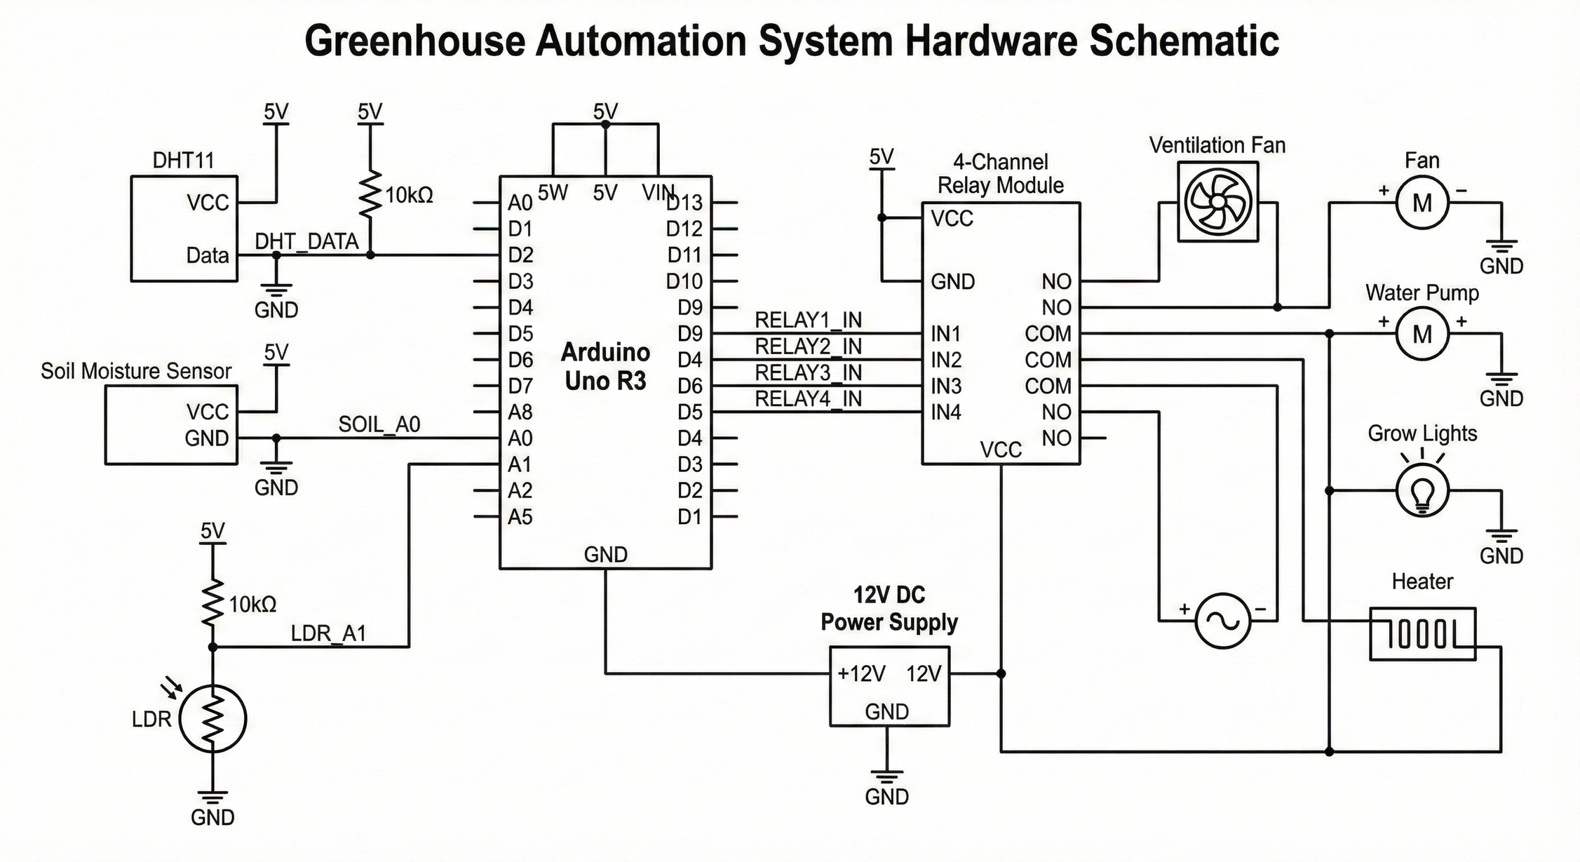

Slide 13
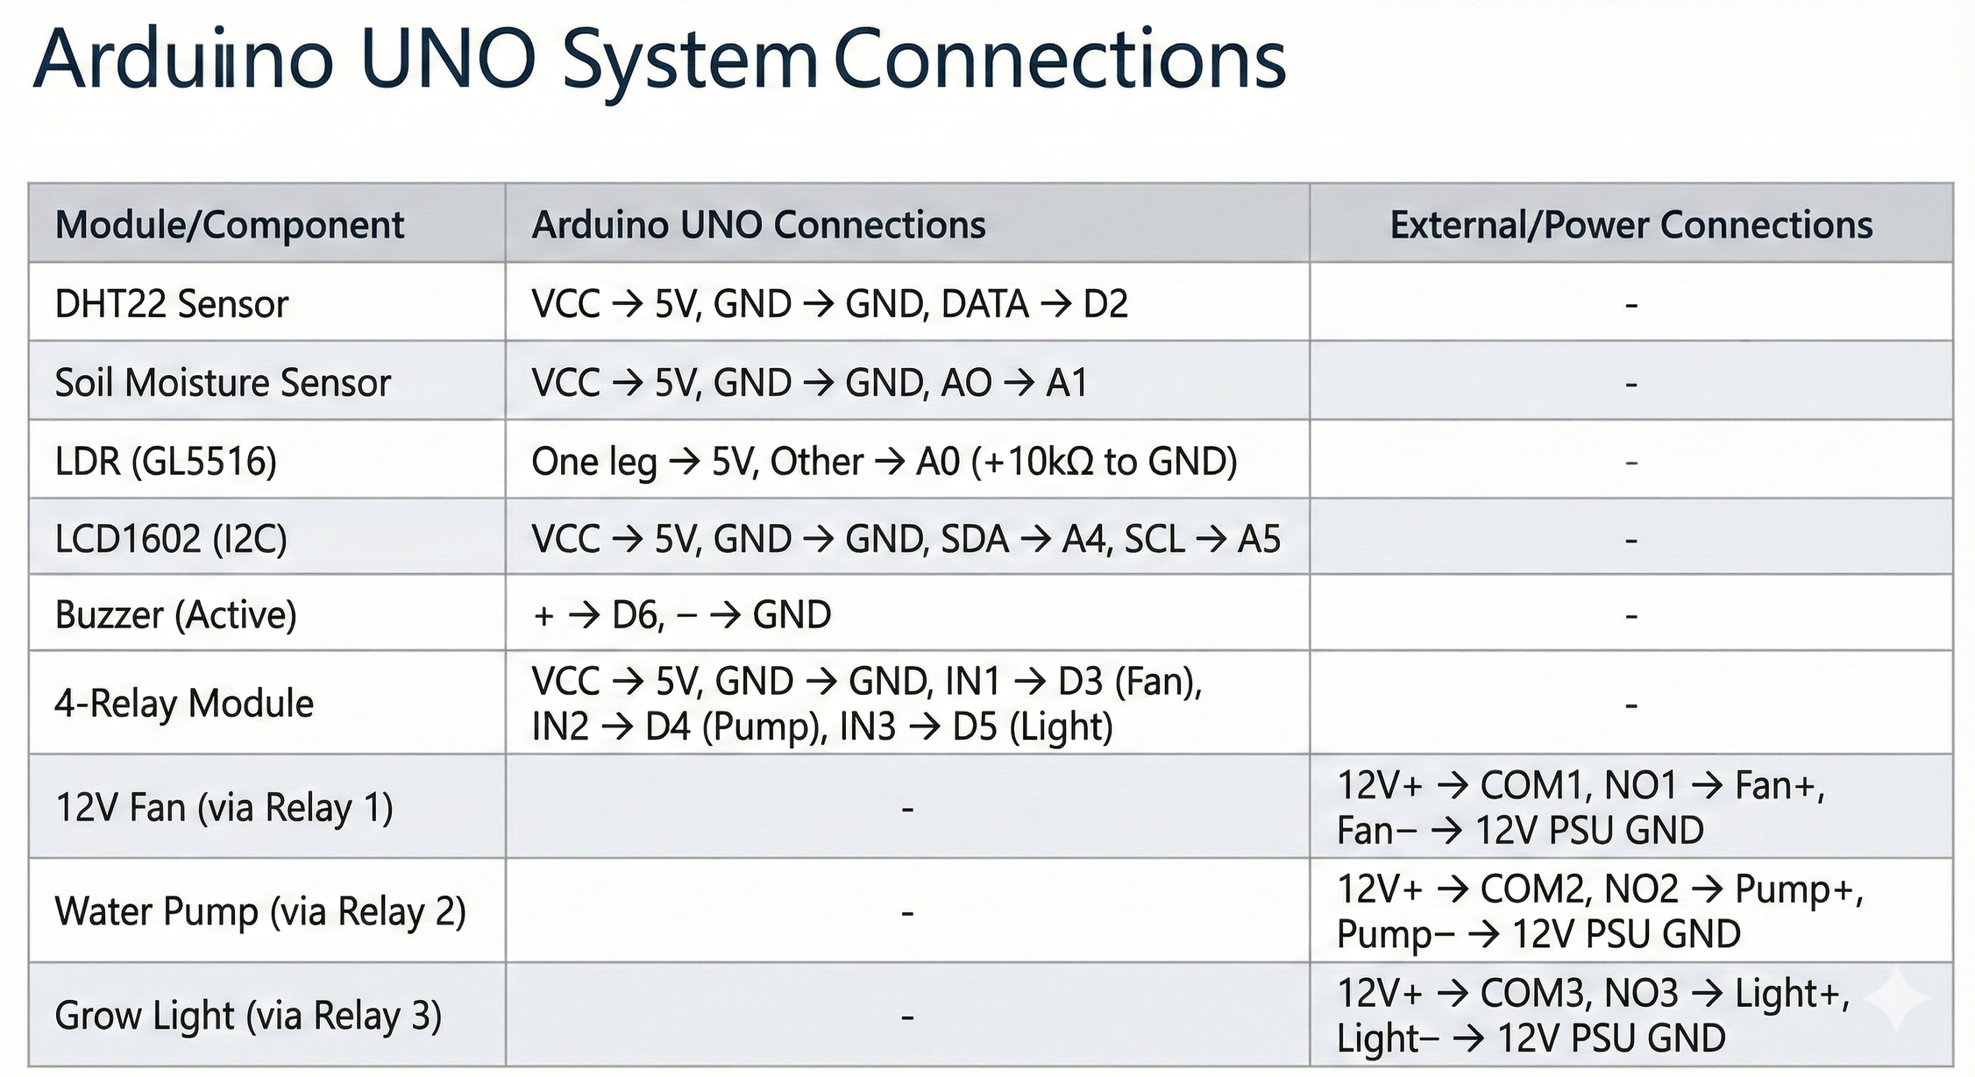
System Components Pin Connection

Slide 14
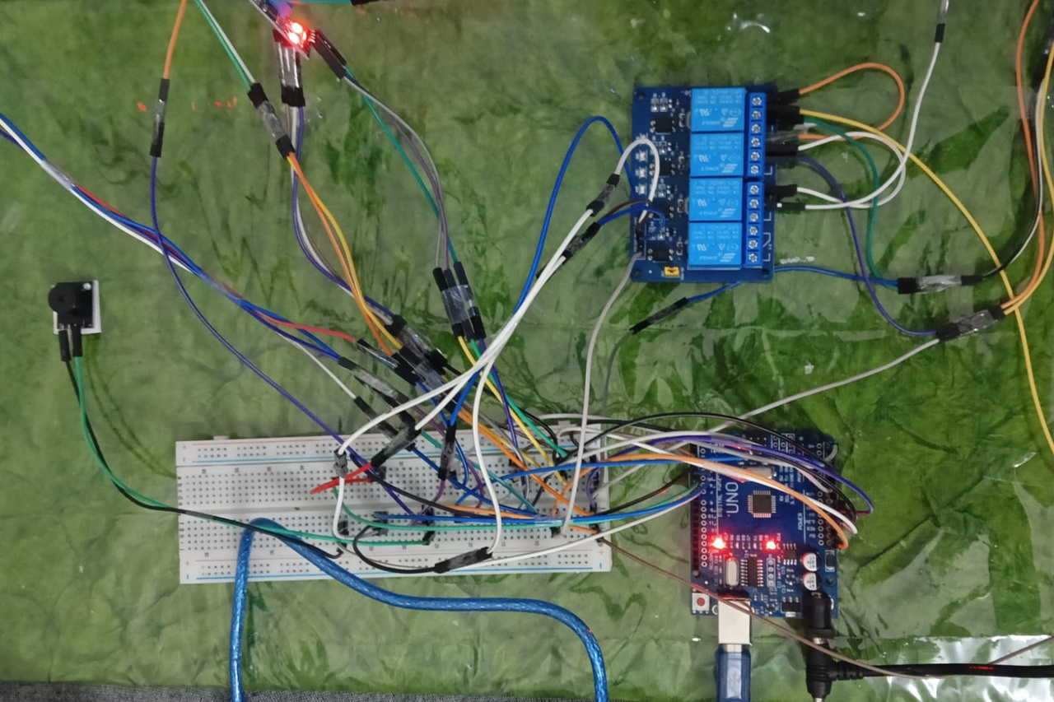
Key Hardware Circuit

Slide 15
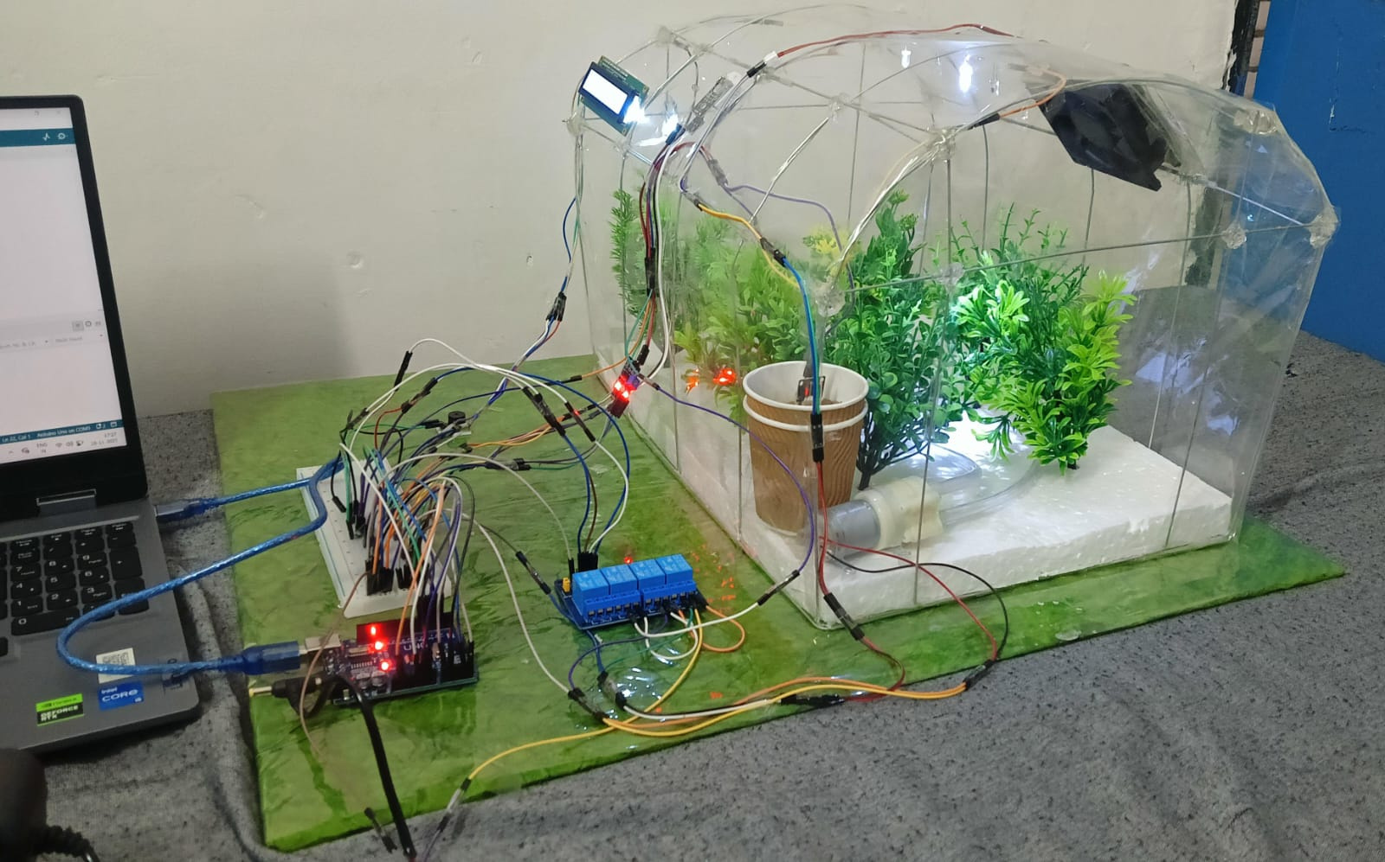

Slide 16
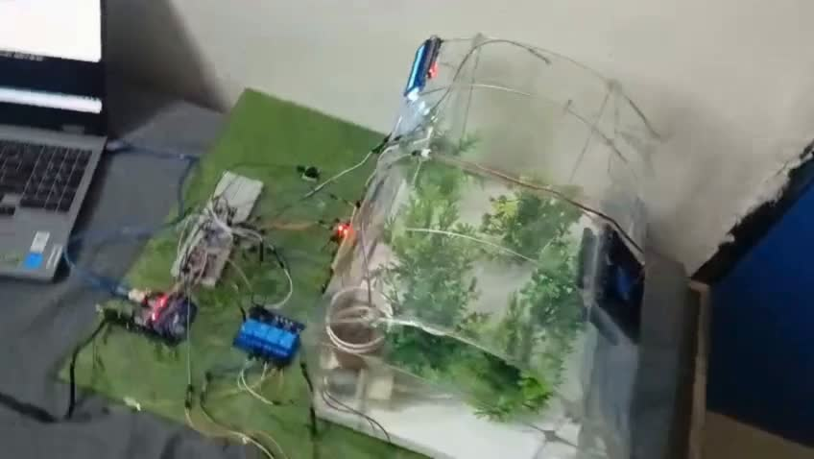

Slide 17

Optimal Temperature Control
Maintain Ideal Temperature
01
By using temperature sensors, Arduino ensures that the greenhouse maintains the optimal climate for plant growth, adjusting the fans and vents as needed to regulate heat.
02
Reduce Energy Waste
Automation minimizes unnecessary energy consumption by efficiently managing ventilation and temperature, resulting in lower operational costs and a greener approach to greenhouse management.

Slide 18
Ventilation Control
Effective ventilation control is crucial in maintaining a stable greenhouse environment. Temperature sensors continuously monitor conditions, while Arduino adjusts fan and vent operations to achieve optimal climate control and energy efficiency.

Slide 19
Automation of LED Grow Lights
Utilizing Light Sensors for Growth
Optimizing plant health with controlled lighting

Slide 20
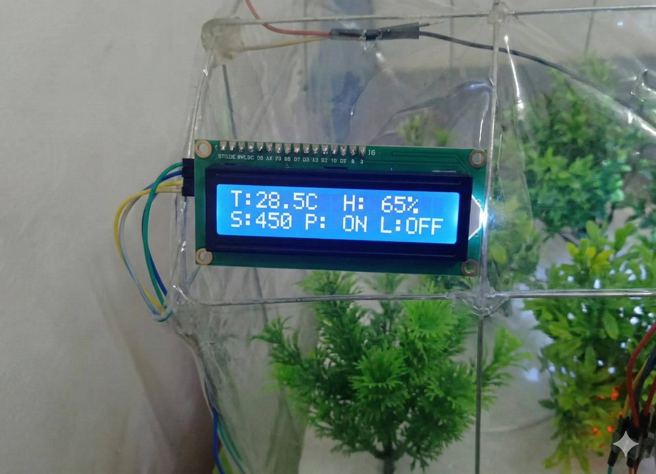
Live System Monitoring (I2C Interface)
Real-Time Dashboard: 16x2 LCD displaying live sensor data.
The system instantly displays the critical environmental metrics: Temperature (28.5 °C), Humidity (65 %), and Soil Moisture (450)

Slide 21
Flow of Automation Process
01
Clear Flowchart
A clear flowchart visually represents the sequence from sensors detecting environmental conditions to Arduino processing inputs and executing actions, ensuring efficient climate management in the greenhouse.
02
Simple Circuit Diagram
A simple circuit diagram illustrates the connections between the Arduino and its components, providing a straightforward view of how data flows and actions are triggered in the automated system.

Slide 22
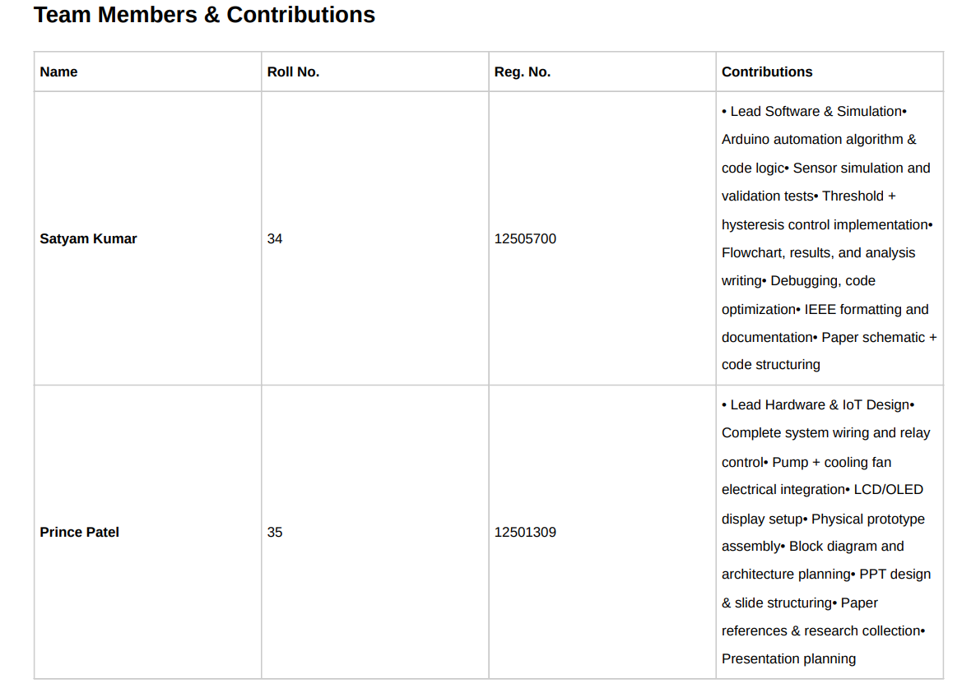

Slide 23
Thank You
Growing a sustainable future

